Slide 1
Alex Lift Company Profile
May 2024

Slide 2
Table of Contents
About Alex Lift
Mission, Vision & Values
Facility
Alliances
Our Clients
Contacts

Slide 3
About Alex Lift LLC
A Leading Provider of Material Handling Spare Parts and Services in Egypt (founded in 2015)
Founded by a group of experienced professionals in the material handling and heavy equipment field.
Aim to supply the Egyptian market with high-quality spare parts and services.
Extensive network of trusted suppliers.
Headquarters located in Al Mokattam, Cairo, with a sales office in Alexandria.
Warehouse stocked with various fast-moving spare parts.
Strong business alliances with various parts and services suppliers in the market.

Slide 4
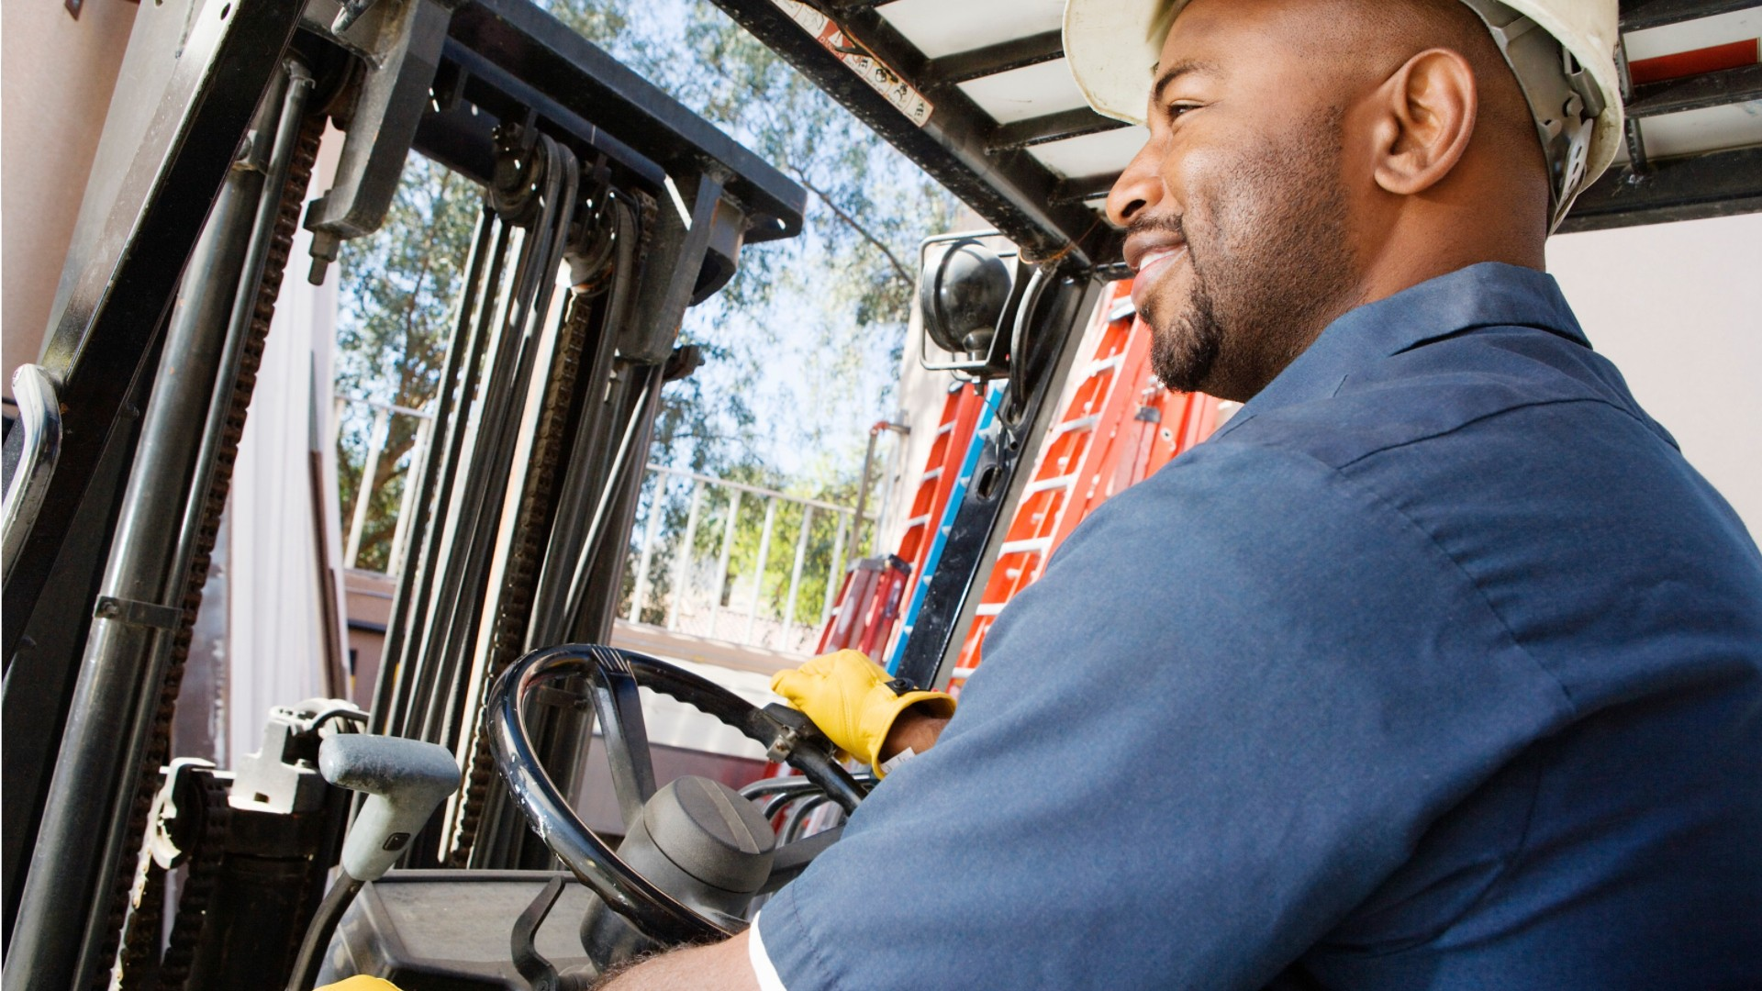
Mission, Vision & Values
Our Mission
Our Vision
Our Values
To be the premier supplier of high-quality spare parts and services for forklifts, material handling equipment, and earthmoving machinery in the Egyptian market. We achieve this by leveraging the expertise of our experienced professionals and fostering strong partnerships with trusted suppliers.
To become the leading one-stop shop for all material handling and heavy equipment needs in Egypt. We envision a future where AlexLift is synonymous with reliability, efficiency, and exceptional customer service, empowering businesses to operate at peak performance.
Customer Focus: We prioritize understanding and exceeding our customers' expectations by delivering prompt, efficient, and personalized service.
Partnership & Collaboration: We believe in building strong, collaborative relationships with our suppliers and industry partners to achieve shared success.
Expertise & Innovation: We leverage the extensive knowledge of our team and continuously seek innovative solutions to address the evolving needs of the material handling industry in Egypt

Slide 5
Facility

Slide 6
Facility

Slide 7
Alliances
AlexLift LLC is proud to be an authorized distributor of Mitsubishi Heavy Industries and ZOOMLION, leading global players in the material handling and heavy equipment industry
In addition to our authorized partnerships, AlexLift LLC leverages its extensive network to source parts from Mantrac, the sole distributor of Caterpillar in Egypt, and EIM, the sole distributor of TCM in Egypt

Slide 8
Our Clients
Trusted by leading companies across various industries

Slide 9
Contacts
Phone: (+20) 12 390 8499
Address: 209 Abol Abbas Administrative Building, Alexandria, Egypt
7567 El Gamea El Haditha St., El hadaba el wosta, El Moqattam, Cairo, Egypt
E-mail: sales@alexlift.com
Website: www.alexlift.com
Location (Google Maps): https://maps.app.goo.gl/8NH25mGYMeRW3rNj9

Slide 10
Don’t Stop. We’ve got you covered.

